Slide 1
Bus company | Price | Covered area | validity
Kyoto city bus Kyoto bus | \600 adult \300 child (age 6-12) | Within flat fare zone* | 3 times and more 🚌 🚌 🚌
Normal Bus fare : \230 for an adult, \120 for a child per ride.
*flat fare zone: Most famous spots are within flat fare (=\230)
zone, except for Kurama, Kifune, Takako and Ohara.

Slide 2
☑ Location : northeast of Kyoto city
☑ Distance : 4.7 mile (7.6 km) from Kyoto Station
☑ Transportation & Time / Fare for an adult
🚋 🚌 Subway & Bus | 30- 35 min | ¥490 (¥430 if IC card)
🚌 only Bus | more than 40 min | ¥230
🚖 Taxi | 25- 30 min* | about ¥2200*
🚲 Bicycle | about 45 min
∗need more time and fare on peak season because of heavy traffic jam
☑ From Nearest Bus Stop…
➀ Ginkakuji-mae : walk 4 min, ② Ginkakuji-michi : walk 7 min ☑ From Nearest Station… ➀ Demachiyanagi (Keihan Railway) : walk 30 min ( 1.5 mile / 2.4 km) ② Keage (Subway Tozai line) : walk 35 min (1.75 mile / 2.8 km)

Slide 3

☑ Location : northeast of Kyoto city
☑ Distance : 4.7 mile (7.6 km) from Kyoto Station
☑ Transportation & Time / Fare for an adult
🚋 🚌 Subway & Bus | 30- 35 min | ¥490 (¥430 if IC card)
🚌 only Bus | over 40 min | ¥230
🚖 Taxi | 25- 30 min* | about ¥2200* a car
🚲 Bicycle | about 45 min
∗need more time & fare on peak season because of heavy traffic jam
☑ From Near Bus Stop…
➀ Ginkakuji-mae : walk 4 min
② Ginkakuji-michi : walk 7 min

Slide 4
☑ Location : northwest of Kyoto city
☑ Distance : 5.3 mile (8.6 km) from Kyoto Station
☑ Transportation & Time / Fare for an adult
🚋 🚌 Train(JR) & Bus | 25 min | \420
🚋 🚌 Subway & Bus | 30 min | ¥490 (¥430 if IC card)
🚌 only Bus | over 37 min | ¥230
🚖 Taxi | 25- 30 min* | about ¥2500* a car
🚲 Bicycle | about 50 min
∗need more time & fare on peak season because of heavy traffic jam
☑ From near Bus Stop… ➀ Kinkakuji-michi : walk 4 min
② Kinkakuji-mae : walk 1 min, but No service from Kyoto Sta.

Slide 5
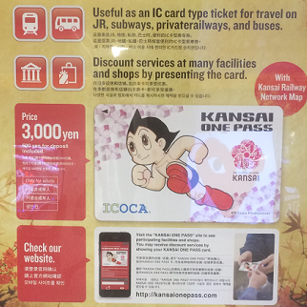
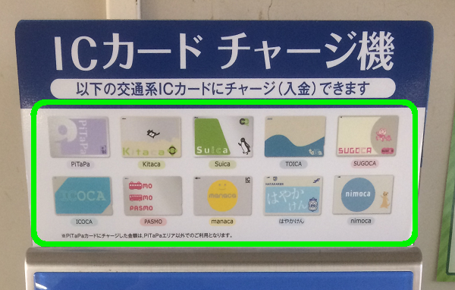

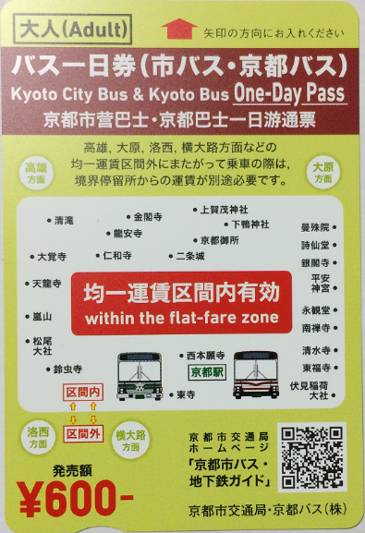
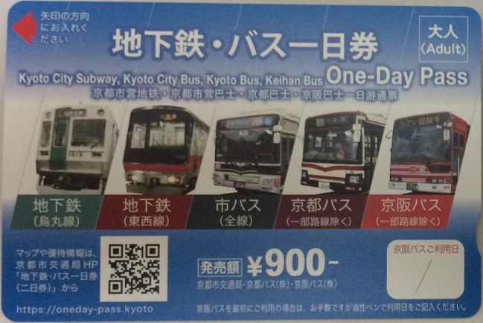
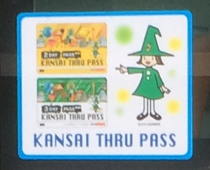

JR pass
IC card
Kansai One Pass
Subway & Bus pass
Bus 1day pass
Kansai Thru Pass

Slide 6

OK
IC card
Kansai One Pass
Kansai Thru Pass
Available for limited area
Unavailable
JR pass
Bus one-day pass
Subway & Bus pass

Slide 7
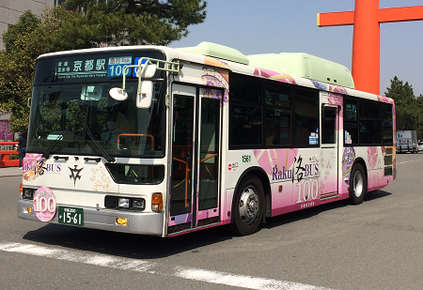
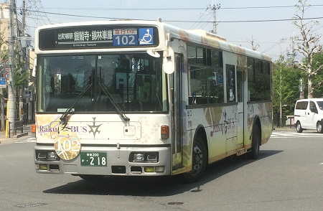
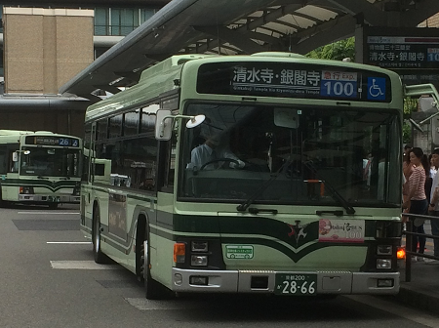
Raku Bus
in Kyoto

Slide 8
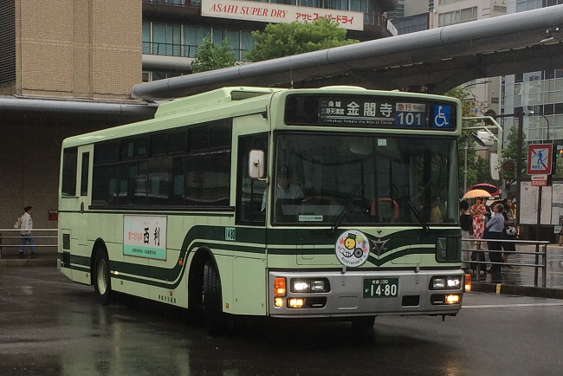
Raku Bus
in Kyoto

Slide 9
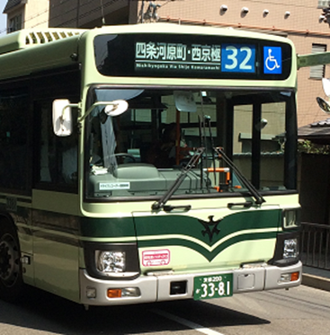
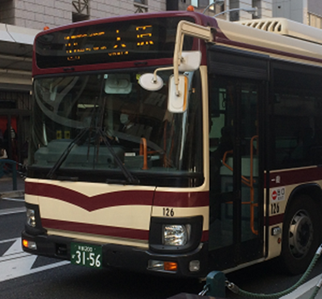
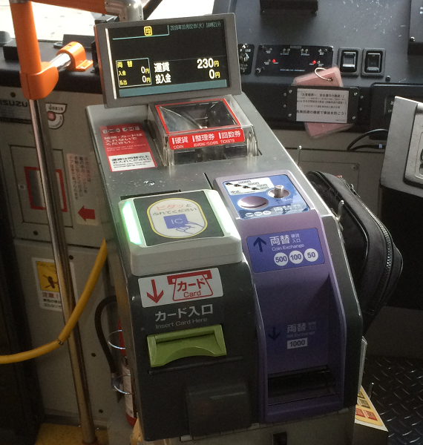
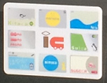
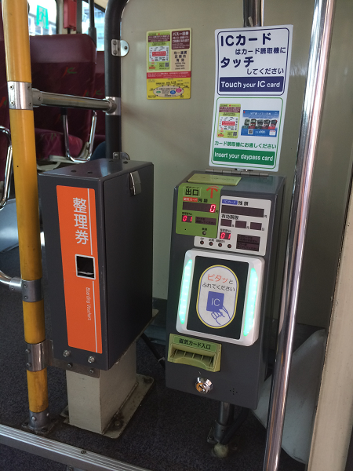
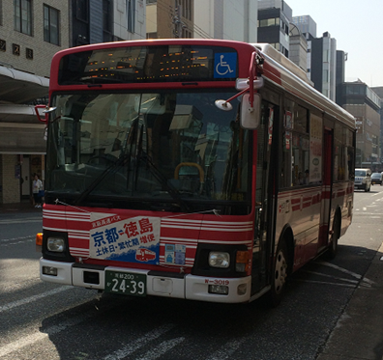
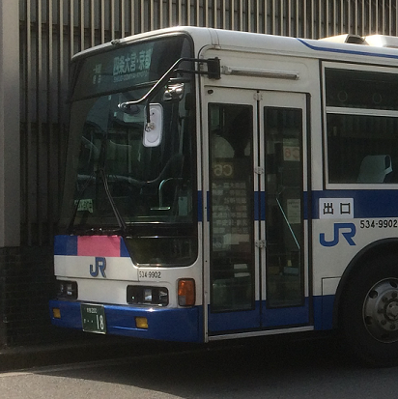
How to use IC cards (Kansai One Pass)
🚌
within
Flat Fare Zone
City Bus
Kyoto Bus
Touch when you get off
🚌
City Bus
beyond
Flat Fare
Zone
Keihan Bus
Kyoto Bus
Touch when get on & off
JR Bus

Slide 10
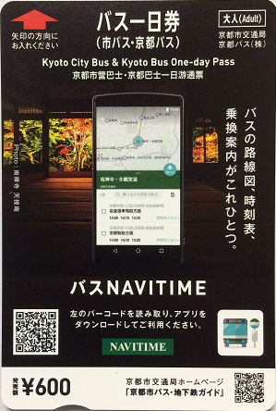
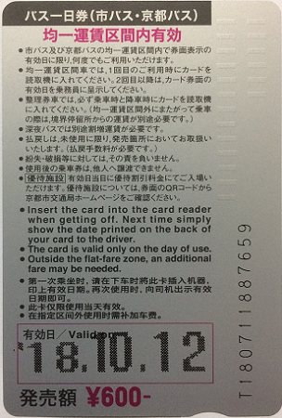
How to use Bus One day pass
🚌
When first
ride
INSERT when get off
Kyoto bus
🚌
Second ride or later
No need to insert
Kyoto City bus
Just SHOW when get off

Slide 11
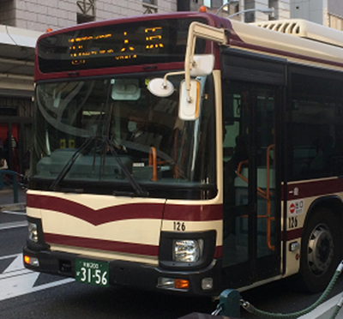
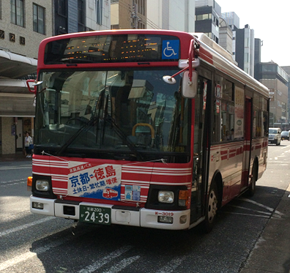
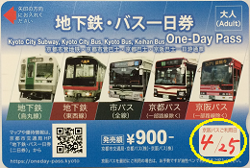
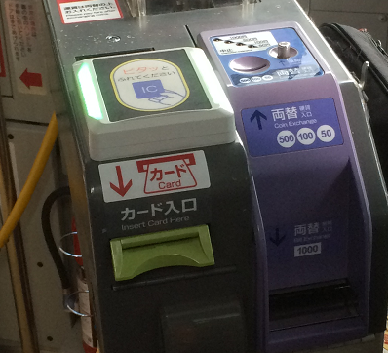
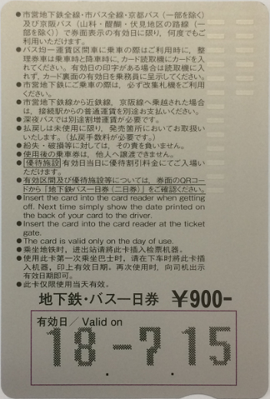

How to use Subway & Bus day pass
🚌
When First
Ride
Only Keihan Bus
City Bus
Kyoto Bus
Insert when get on buses
running beyond flat fare
Write down the date,
and show when get off
Insert when get off
🚌
Second Ride or Later
From valid to invalid area, Kurama / Kibune
🚌
Insert when
get on & off,
pay extra fare
No need to insert
Just show when get off

Slide 12

How to use Kansai Thru Pass
🚌
When First
Use
Only Keihan Bus
Write down the date,
and show when get off
Insert when buses
beyond flat fare
Insert when get off
🚌
Kyoto City Bus
After the date printed
No need to insert
Kyoto Bus
Keihan Bus
Just show when get off

Slide 13



How to Pay
Bus Fares
by CASH
Kyoto City Bus
Kyoto Bus
Keihan Bus
JR Bus
🚌
within
Flat Fare Zone
Fare Box
🚌
Pay by coins When
get off (exact amount)
🚌
beyond
Flat Fare
Zone
Take numbered ticket when get on
Change Machine

Slide 16
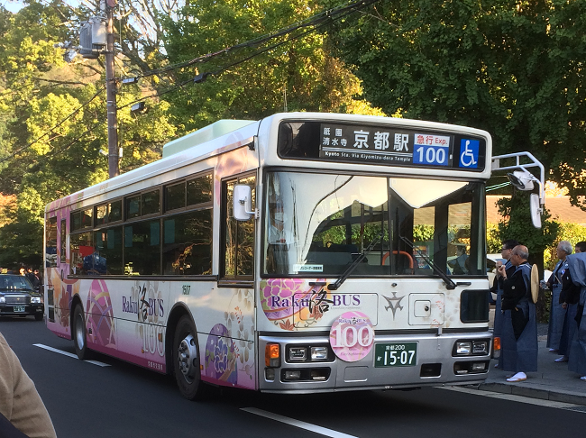
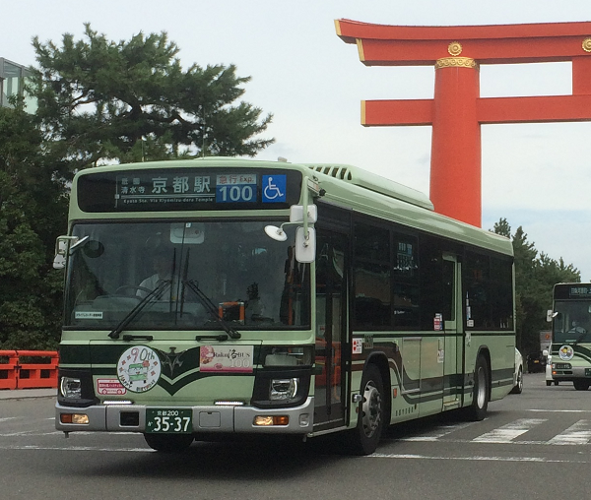
Raku Bus No.100 in Kyoto

Slide 17
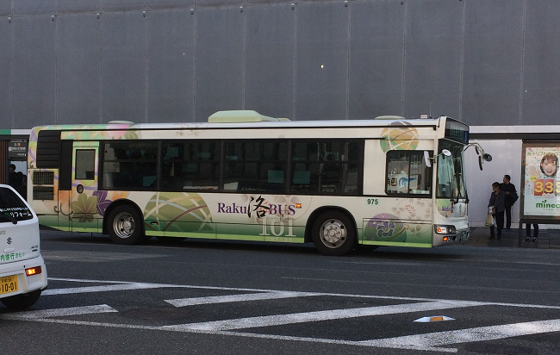
Raku Bus No.101 in Kyoto

Slide 18
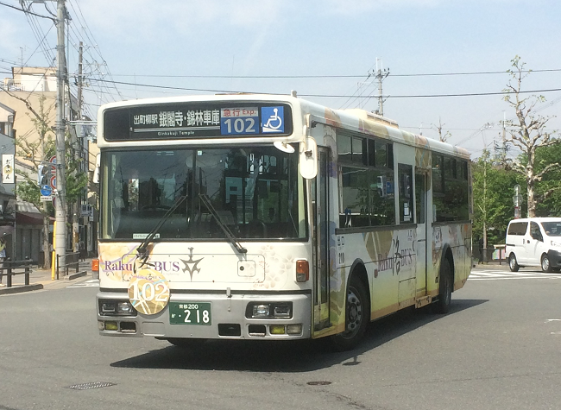
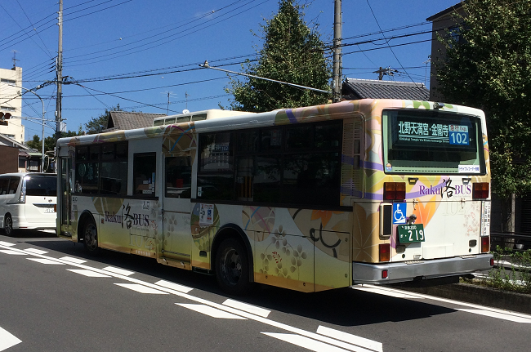
Raku Bus No.102 in Kyoto

Slide 19
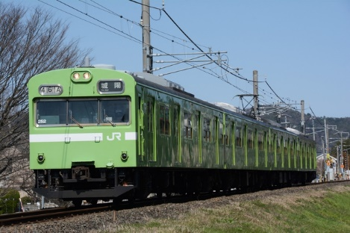
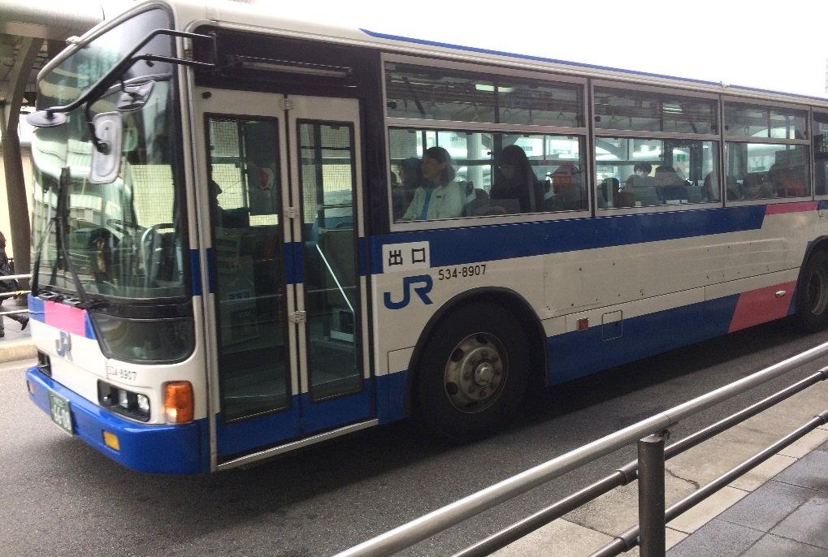
Using Japan Rail Pass in Kyoto
💳
JR

Slide 20
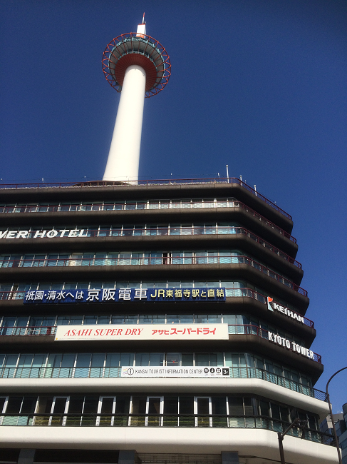
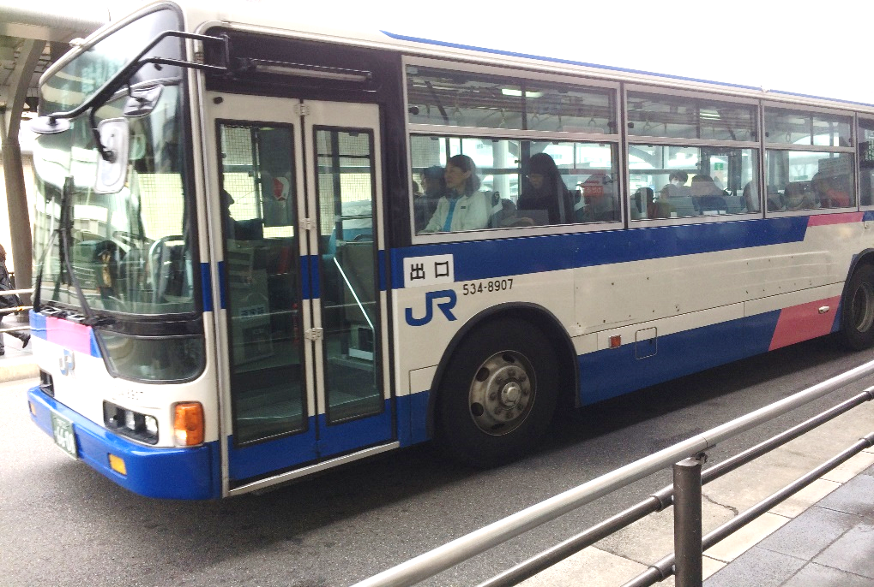
Which is JR Local Bus in Kyoto ?
For JR Pass Use
💳
JR

Slide 21
Which is JR Line in Kyoto ?
For JR Pass Use
💳
JR

Slide 22


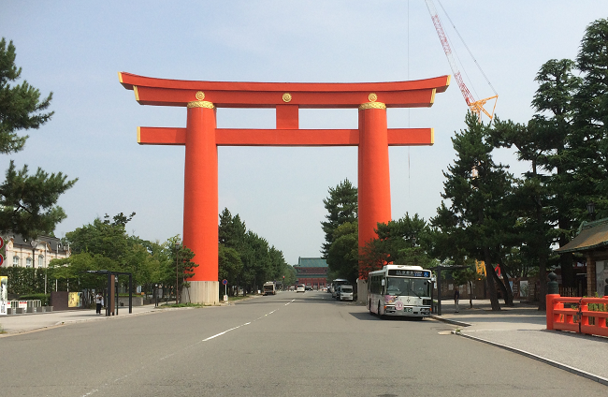
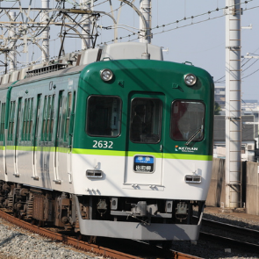
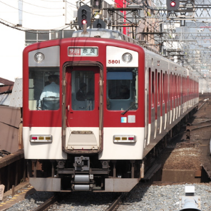

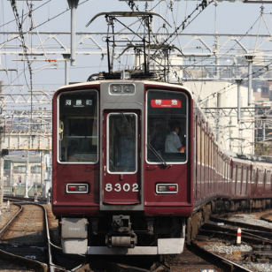

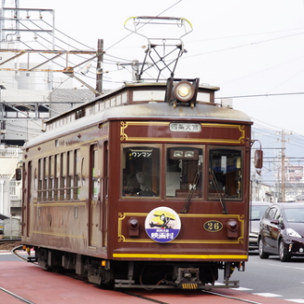
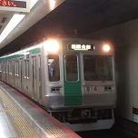
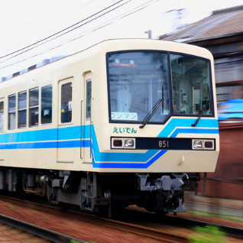
Buses & Trains in Kyoto
Public Transport System

Slide 23
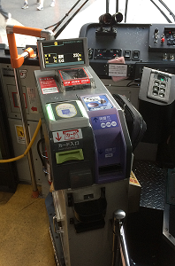
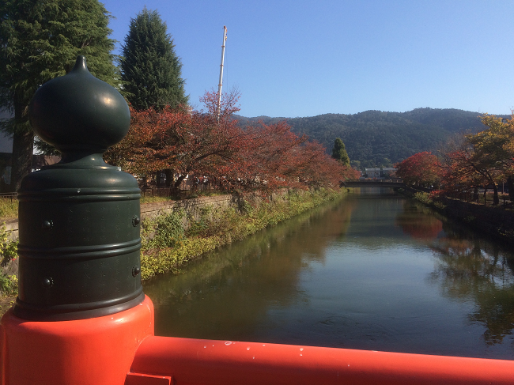
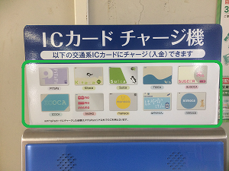
Local Bus Fares in Kyoto
How much & How to pay
￥

Slide 24


Use IC Cards on Buses & Trains
in Kyoto (Discount Service Available)

Slide 25
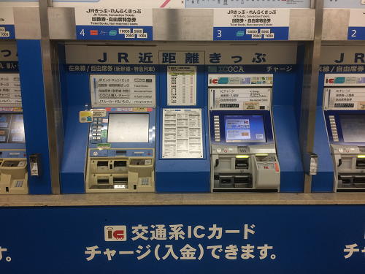
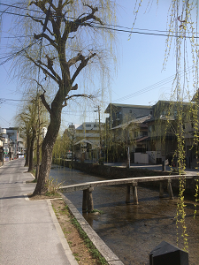
Where & How to buy IC Cards
in Kyoto

Slide 26
Kansai One Pass in Kyoto
Comparison with Kansai Thru Pass

Slide 27
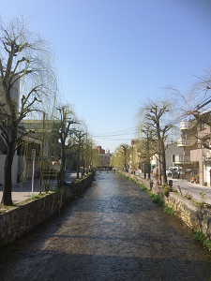
Bus One-Day Pass in Kyoto

Slide 28
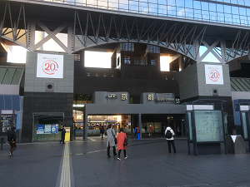
Where to buy Bus One-Day Pass in Kyoto

Slide 29
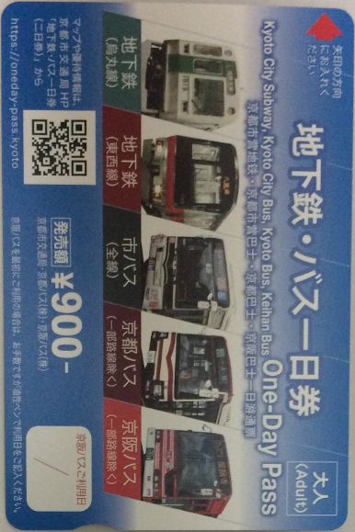
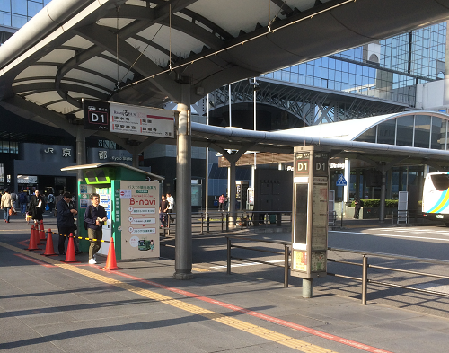
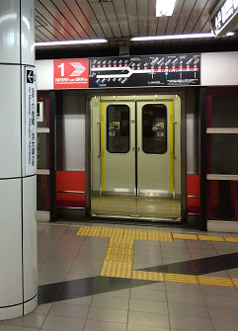
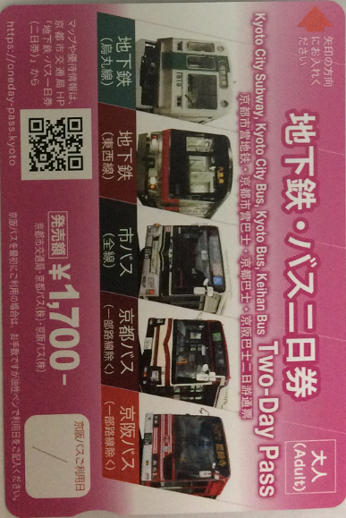
Where to buy Subway & Bus Day Passes in Kyoto

Slide 30



Subway & Bus Day Passes in Kyoto

Slide 31


Main Day Passes in Kyoto
Type, Price, Area

Slide 32


How to Get to Ginkakuji Temple
From Kyoto Station

Slide 33



How to Get to Kinkakuji Temple
From Kyoto Station

Slide 34
JR pass
OK
Unavailable
IC card
Kansai One Pass
Available for All Routes
Kansai Thru Pass
Subway & Bus pass
Bus one-day pass

Slide 35
Flat Fare Zone only
OK
IC card
Kansai One Pass
Bus one-day pass
Available for All Routes
JR pass
Unavailable
Kansai Thru Pass
Subway & Bus pass

Slide 36
JR pass
OK
Unavailable
JR Pass
IC card
Kansai One Pass
Available for almost
All Routes
Unavailable
Kansai Thru Pass
Subway & Bus pass
Bus one-day pass

Slide 37
Kyoto City Bus & Subway | Kyoto Bus | Keihan Bus
ALL services available | Most services available
 | *excluded : Kurama area, Kyoto Sta. to Mt. Hiei line | *excluded : Mt. Hiei line, Airport line
☆West JR Bus : unavailable

Slide 38
type | Price adult child (6-12)
Subway & Bus 1 Day Pass | \900 | \450
Subway & Bus 2 Day Pass | \1700 | \850

Slide 39

type | Price adult child (6-12)
Bus 1 Day Pass | \600 | \300
Subway & Bus 1 Day Pass | \900 | \450
Subway & Bus 2 Day Pass | \1700 | \850

Slide 40
Bus 1 day pass
\600 adult \300 (age 6-12)
Bus Company | Area | Cost Effectiveness
Kyoto city bus Kyoto bus | Within flat-fare zone* | 3 times and more 🚌 🚌 🚌
Normal Bus Fare : \230 for an adult, \120 for a child per ride.
*flat-fare zone: Most famous spots are within flat-fare (=\230)
except for Kurama, Kibune, Takako, Ohara & Yamashina area.

Slide 41
TYPE & PRICE
type | Price (adult) (age 6 -12 ) |  | Validity
BUS 1 DAY PASS | \600 | \300 | 🚌 ride 3 times and more
SUBWAY & BUS 1 Day Pass | \900 | \450 | 🚇+🚌 more than 2times*
SUBWAY & BUS 2 Day Pass | \1700 | \850 | 🚇+🚌 2 times and more a day
*🚌 bus fare is \230, 🚇 subway fare is \210 to \350, depend on your destination
AREA
BUS 1 DAY PASS | Within Flat Fare Zone (include Arashiyama) (ONLY Kyoto City Bus and Kyoto Bus )
SUBWAY & BUS 1 or2 Day Pass | ALL Kyoto City Bus & Subway Most Kyoto Bus service (include Ohara) KEIHAN Bus operated in city center and Yamashina (east side)
Notes:
clude

Slide 42
TYPE & PRICE
type | Price (adult) ( 6 -12 ) |  | Validity
🚌 BUS 1 DAY PASS | \600 | \300 | 🚌 ride 3 times and more
🚇SUBWAY & 🚌BUS 1 Day Pass | \900 | \450 | 🚇 + 🚌 more than 2 times*
🚇SUBWAY & 🚌BUS 2 Day Pass | \1700 | \850 | 🚇 + 🚌 2 times and more a day
*🚌 fare \230, 🚇 fare \210 to \350, depend on your destination

Slide 43
type | Price adult child age 6 -12
Bus 1 Day Pass | \600 | \300
Subway & Bus 1 Day Pass | \900 | \450
Subway & Bus 2 Day Pass | \1700 | \850

Slide 44
Type | Cost Effective
🚌 Bus 1 Day Pass (\600) | 🚌 ride 3 times and more
🚇 🚌 Subway & Bus 1 Day Pass (\900) | 🚇 + 🚌 more than 2 times each
🚇 🚌 Subway & Bus 2 Day Pass (\1700) | 🚇 + 🚌 2 times and more a day
・🚌 fare \230, 🚇 fare \210 - \350 per ride

Slide 45
TYPE & PRICE
type | Price adult child age 6 -12
Bus 1 Day Pass | \600 | \300
Subway & Bus 1 Day Pass | \900 | \450
Subway & Bus 2 Day Pass | \1700 | \850

Slide 46





West JR bus in Kyoto
JR pass
use
Kyoto city bus
Kyoto bus
Keihan bus

Slide 47
West JR Bus in Kyoto
ＯＫ
JR pass
use
Kyoto City Bus
Kyoto Bus
Keihan Bus
Unusable

Slide 48
Kyoto City bus
Kyoto bus
West
JR bus
Keihan bus
Arashiyama,Ohara
⇔ Kyoto sta.,
downtown area
Kurama, Kifune ⇔
Kokusaikaikan sta.
Takao, Shuzan
(northwest area)
⇔ Kyoto sta.
*Only one route
downtown area
⇔ Yamashina area (east side)
Over the
kyoto city

Slide 49
Kyoto City bus
Kyoto bus
West
JR bus
Keihan bus

Slide 50




Keifuku (Randen)
JR
Eizan
Hankyu
City subway
Kintetsu
Keihan

Slide 51
JR Pass use
JR only
Keifuku (Randen)
Eizan
Hankyu
City subway
Kintetsu
Keihan

Slide 52
Kyoto City bus
Kyoto bus
Keihan bus
West
JR bus
Arashiyama,Ohara
⇔ Kyoto sta.,
downtown area
Kurama, Kifune ⇔
Kokusaikaikan sta.
Takao, Shuzan
(northwest area)
⇔ Kyoto sta.
*Only one route
downtown area
⇔ Yamashina area (east side)
Over the
kyoto city

Slide 53



Kyoto City Bus

Slide 54
BUS 1 Day Pass | Within Flat-Fare Zone (ONLY Kyoto City Bus and Kyoto Bus )
SUBWAY & BUS 1 or 2 Day Pass | ALL Kyoto City Bus & Subway Most Kyoto Bus service Most KEIHAN Bus service

Slide 55
Bus 1 Day Pass | Within Flat-Fare Zone (ONLY Kyoto City Bus and Kyoto Bus )
Subway & Bus 1 or 2 Day Pass | ALL Kyoto City Bus & Subway Most Kyoto Bus service Most Keihan Bus service

Slide 56
BUS 1 Day Pass | Within Flat Fare Zone (ONLY Kyoto City Bus and Kyoto Bus )
SUBWAY & BUS 1 or2 Day Pass | ALL Kyoto City Bus & Subway Most Kyoto Bus service Most KEIHAN Bus service

Slide 57
TYPE & PRICE
type | Price (adult) (age 6 -12 ) |  | Validity
BUS 1 DAY PASS | \600 | \300 | 🚌 ride 3 times and more
SUBWAY & BUS 1 Day Pass | \900 | \450 | 🚇+🚌 more than 2times*
SUBWAY & BUS 2 Day Pass | \1700 | \850 | 🚇+🚌 2 times and more a day
*🚌 bus fare is \230, 🚇 subway fare is \210 to \350, depend on your destination
AREA
BUS 1 DAY PASS | Within Flat Fare Zone (include Arashiyama) (ONLY Kyoto City Bus and Kyoto Bus )
SUBWAY & BUS 1 or2 Day Pass | ALL Kyoto City Bus & Subway Most Kyoto Bus service (include Ohara) KEIHAN Bus operated in city center and Yamashina (east side)
Notes:
clude

